Slide 1

DESIGNER
Jose Alberto Nieto Ros
EA5HVK

Slide 2
THE VARA MODEM
Introduces a new standard of technology available for Amateur and Commercial use
HF HIGH PERFORMANCE DATA
INTEGRATION
Fully integrated with the established
RMS Express E-Mail handling system
Gate-way & Client requirements

Slide 3
VARA design
VARA Modem, brings state of the art Military grade technology to new and existing HF data .
OFDM provides unique access to high speed , error free , data transfer with limited power budgets , at s/n levels lower than existing conventional data modes.

Slide 4
VARA Tec DATA
VARA is a High Speed HF modem based on OFDM modulation.
42 bps Symbol Rate with 52 carriers
Designed for operation within a SSB Bandwidth of 2400 Hz
Providing uncompressed User Data Rate to 5802 bps at a low (S/N 15 dB @ 4kHz)
Fast adaptive 11 speed levels
Turbo Codification

Slide 5
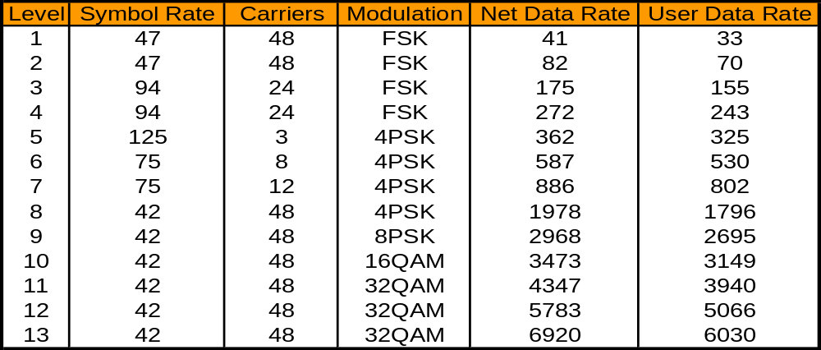
11 Data levels adapting to
Power level and link conditions
VARA
CONFIGURATION

Slide 6
VARA
Implementation
VARA modem is fully software based , utilising conventional Sound-Card audio interface, ensuring compatibility with a wide range of new and existing equipments
VARA Modem is distributed as a MS Windows based “Self extracting” installation package.
Gateway and Client , modes are selectable from the same installation

Slide 7
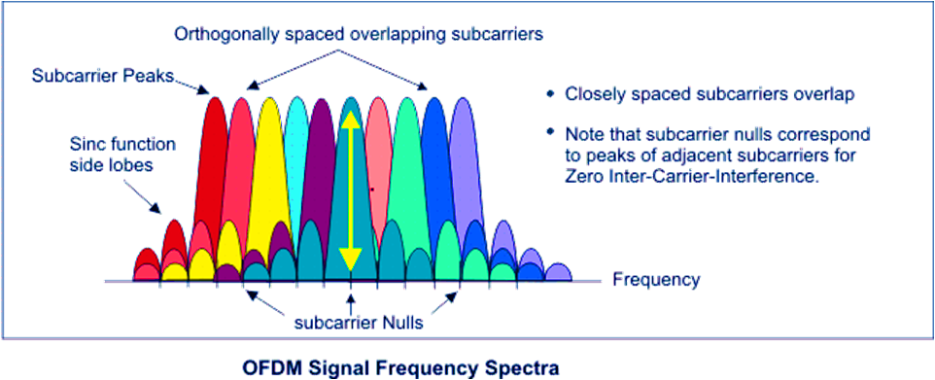
VARA OFDM SPECTRE

Slide 8
VARA in the USA
VARA Modem is deployed as a ‘Virtual Modem’ via ‘Audio in a SSB’ channel,
Design limitations linked to FCC single carrier 300 bps symbol rates are negated by OFDM.
VARA OFDM , Deploys with a On-Air FIXED 42 bps symbol rate per carrier, ensuring link survival in the extremes of HF conditions.

Slide 9
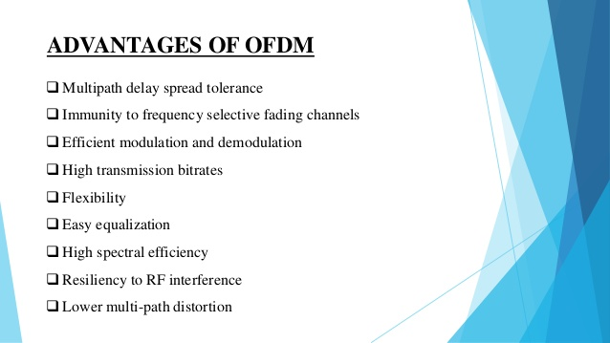

Slide 10
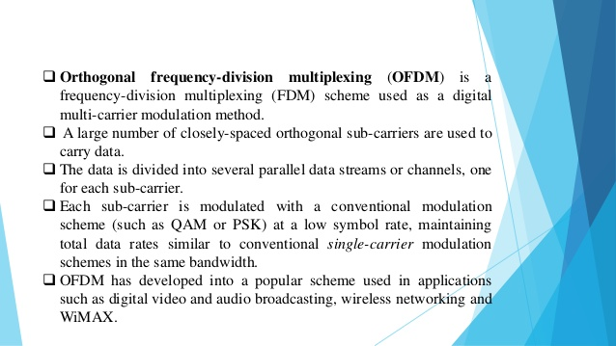

Slide 11
VARA
EFECTIVE END USER technology
VARA unique design, utilises full ARQ and ADAPTIVE link management
VARA is modelled for HF propagation conditions'
ROBUST and RELIABLE link, maintained
under varying propagation conditions,
QRM and Tx Power level.

Slide 12
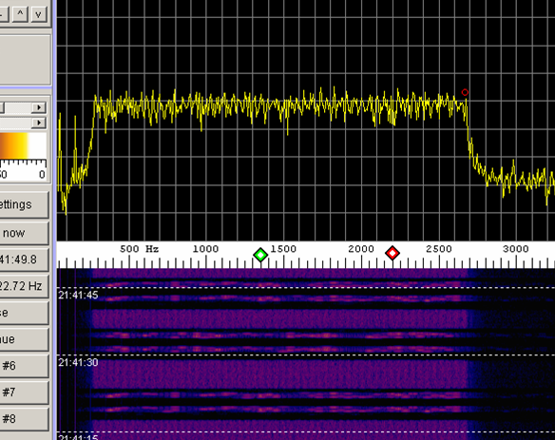
VARA on AIR
Link negotiation
Full use of 2.4 KHz SSB B/W
DATA
ARQ
DATA
ARQ

Slide 13
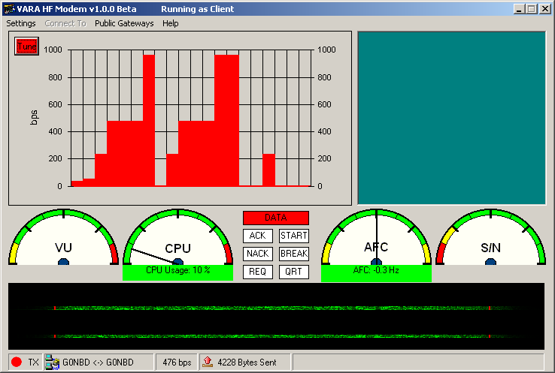
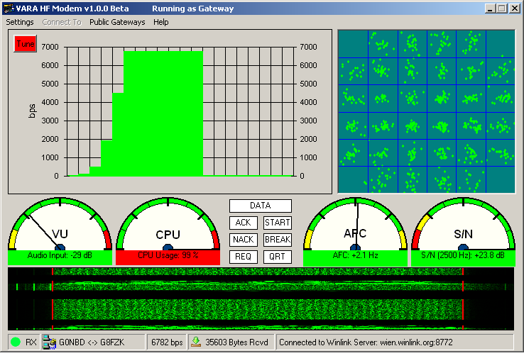
VARA User interface
TX Mode
Link throughput and Data block delivery is presented as a dynamic moving time-line display
RX Mode
Received data blocks are shown on the moving time-line display
Signal quality and mode
selection is presented as an adaptive Constellation display

Slide 14
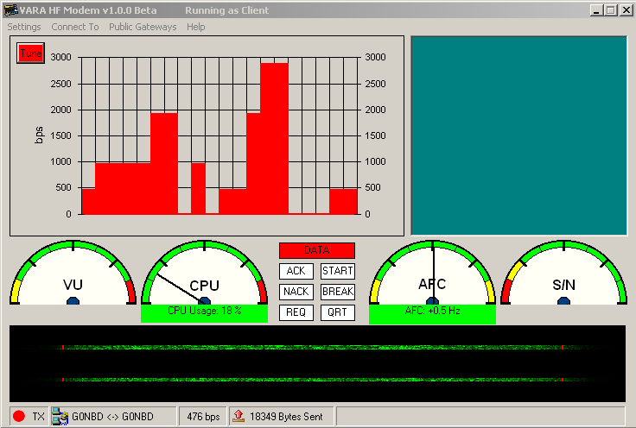
Video of Live on-air
Email transfer QRG 10 MHz
1000 mile path UK<>EA

Slide 15
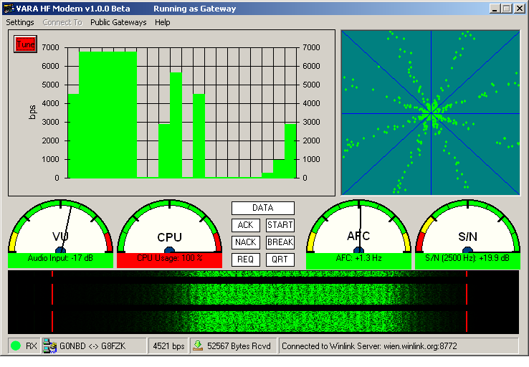
Demonstration of sudden loss of 50%RX Data during maximum speed transfer of 7K bps
LINK Survival in QRM
VARA provides un-paralleled In-Band QRM rejection
Modem recovered link, with an adaptive speed reduction to 3K bps ARQ ensured integrity of received data

Slide 16
Modem transferring E-Mail at
6782 BP/S Gateway
RX screen

Slide 17
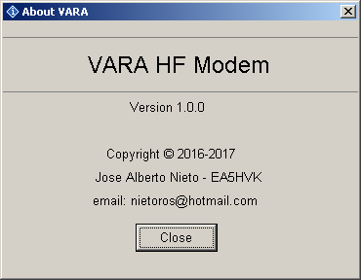
This presentation was produced to provide a
Over view of the new , VARA OFDM HF Modem
The system remains in development , further information and advice is available from the
designer
nietoros@hotmail.com

